Slide 1

Text Analysis of Aviation Safety Data
Predict 453 – Final Project Report
Rahul Sangole Mar 17 2018

Slide 2
Contents
Problem Statement
Approach
Input Data
Exploratory Data Analysis
Data Preprocessing
Modeling
Document Term Matrix
TF-IDF
tSNE
Structural Topic Modeling
Conclusions
Lessons Learnt
References

Slide 3
Data Source
This is the dataset used for the SIAM 2007 Text Mining competition¹.
This competition focused on developing text mining algorithms for document classification.
The documents in question were aviation safety reports that documented one or more problems that occurred during certain flights.
The goal was to label the documents with respect to the types of problems that were described. This is a subset of the Aviation Safety Reporting System (ASRS) dataset, which is publicly available.
¹ https://c3.nasa.gov/dashlink/resources/138/

Slide 4
Approach
Explore the data
How can I use the labels / categories?
Text Preparation
Text Corpus (Xs)
Labels (Y)
Eliminate non-unique categories
Remove airport IATA codes
Strip whitespaces
Case to lower
Handle period separation
Remove punctuation
Remove too common words
Remove taxiway designations
Tidy Text
One row per “category + dsid + word + count”
TF-IDF calculations upon category
tSNE investigation into underlying structures of term-document-matrix
How many structures show up? These could indicate # of topics
Structural Topic Models
Use tSNE to identify # of topic models
Specify # of topic models
Post process STM models
Interpret the model results
Plots
Quantitative results
Text Preparation
Remove stopwords
Identify non-unique categories
What level of aggregation should I consider my DSIDs?

Slide 5
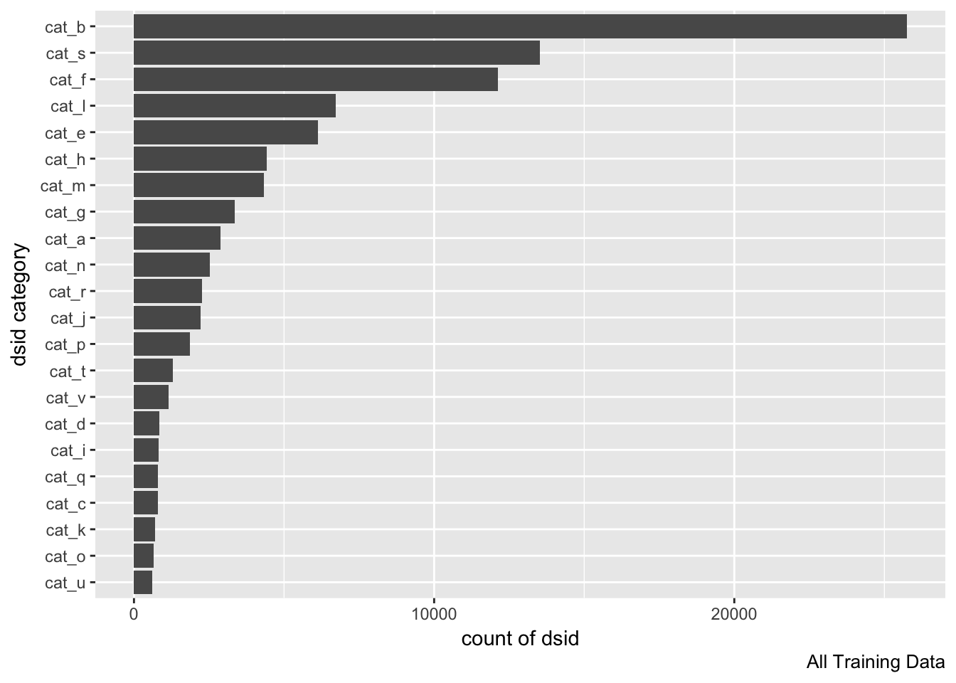
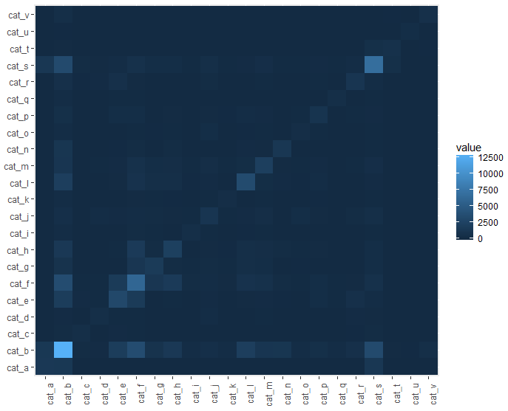
Input Data
This is a very large dataset: [21519, 24]
Each of the 21519 DSI is an aviation safety report
There are a total of 22 categories. The categories aren’t labeled. Does each category correspond to a topic? Or are there multiple topics within each category?
Each DSID can belong to more than 1 category. [If this was false, all off diagonal cells would be dark].

Slide 6
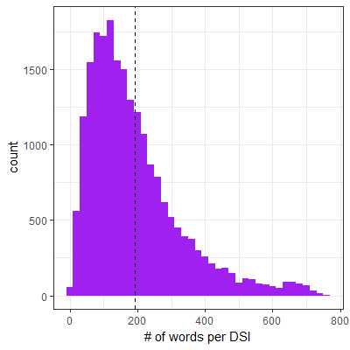
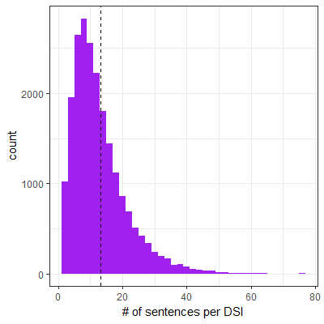
Exploratory Data Analysis
Interesting artifacts
“pass flightlevel climb TO flightlevel RUDDER RATIO AND AILERON LOCKOUT engineindicationandcrewalertingsystemmessage occur.near LEVELOFF captain south ALTIMETER fail AND UNWOUND TO _ feet.WE level OFF us firstofficer south ALTIMETER AFTER A deviate OF _ feet.left centralairdatacomputer HAD fail”
There is a mixture of lowercase and UPPERCASE words
Some lowercase words seem to be pre-processed tokens (bi / tri grams)
Sentences are separated by a period with no adjacent spaces
Numbers have been replaced by _
Stemming seems to have been done
Airport IATA codes show up in lowercase
“ON taxiout AT bos airport I miss A TURN AND CAME INTO CONFLICT WITH AN aircraft _.WE BOTH CAME TO A STOP AND I realize MY MISTAKE.THERE WAS NEVER ani DANGER OF hit EACH OTHER.I WASWAY.humanfactor give OTHER taxiinstruction BY ground AND WENT ON MY DURING taxiout THE firstofficer IS frequent OUT OF THE LOOP get LOAD DATA AND takeoff perform.BOTH set OF eye ARE need DURING TAXI.AFTER EVENT OF _ IT HAS BEEN hard TO FOCUS AND CONCENTRATE.firstofficer south HAVE TOLD ME THIS ALSO.WE NOW MORE THAN EVER FORCE OURSELVES TO BE mind OF THE TASK AT HAND.”

Slide 7
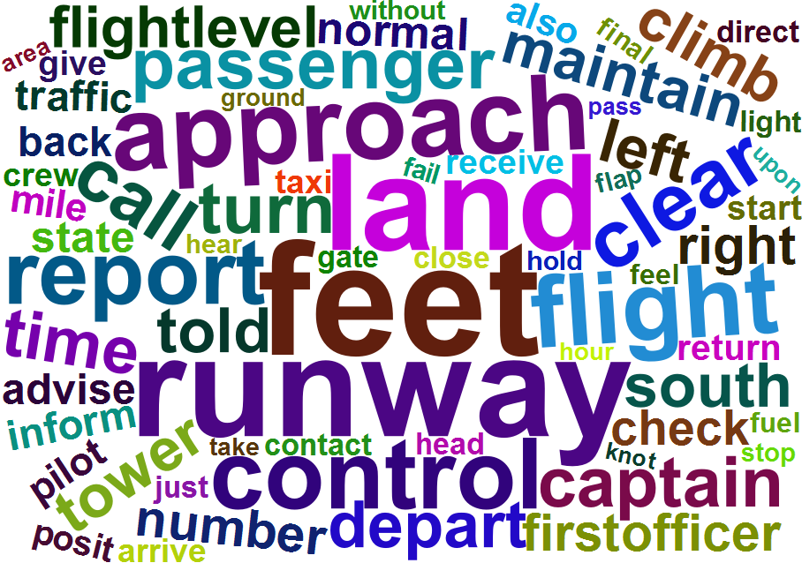
Word Cloud

Slide 8
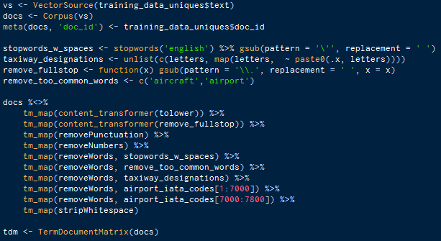
Data Processing
Remove non-unique categories
Handle period separation
Remove punctuation
Remove stopwords
Remove too common words
Remove taxiway designations
Remove airport IATA codes
Strip whitespaces
Case to lower
approximate _ ON september _ captain call ask WHERE hi CLOSEOUT WAS.THE loadagent work THE flight inform ME THAT THE FINAL CARGO number WERE NOT enter YET AND THERE WAS A CHANCE THE flight MIGHT BE OVER THE maximum RAMP weigh.WHEN THE FINAL CARGO number WERE final receive BY THE loadagent SHE BECAME suspicion AS TO THE FIGURE…
approximate september captain call closeout loadagent work flight inform final cargo number enter yet chance flight might maximum ramp weigh final cargo number final receive loadagent became suspicion figure…

Slide 9
Modeling
Modeling Approaches
TF-IDF Based
STM Based
tSNE Based
Using existing known categories and TF-IDF, can we identify patterns in the categories?
Using only the term-document-matrix, can we identify any patterns? How many topics exist in the corpus?
Using only the term-document-matrix, can we identify topics in the corpus? How many topics? What are the topics? How do they agree with the known categories?

Slide 10
How I’m defining a DSI
For TF-IDF Analysis
For STM Analysis

Slide 11
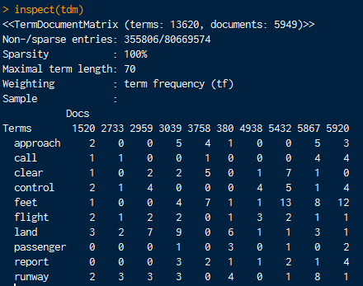
Equivalence Classes, Reference Term Vectors, Document Term Matrix

Slide 12
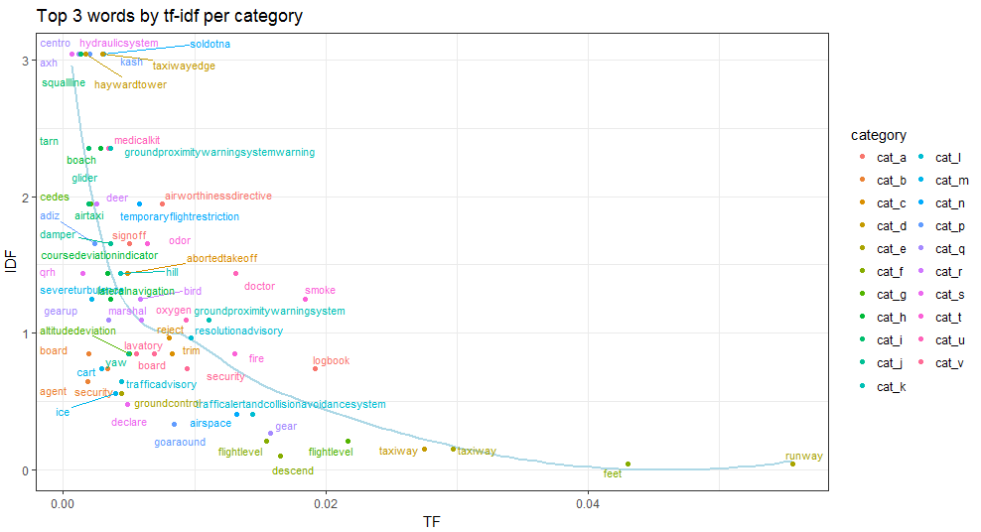
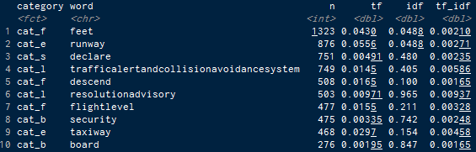
TF-IDF Based Analysis
Some terms are very exclusive to certain categories, with high values of IDF and low values of TF. Ex: hydraulicsystem for cat_s
Others terms like runway show up in a lot more documents, yet have high TF values for certain categories like cat_d
Both these instances result in high TF-IDF values within the respective categories

Slide 13
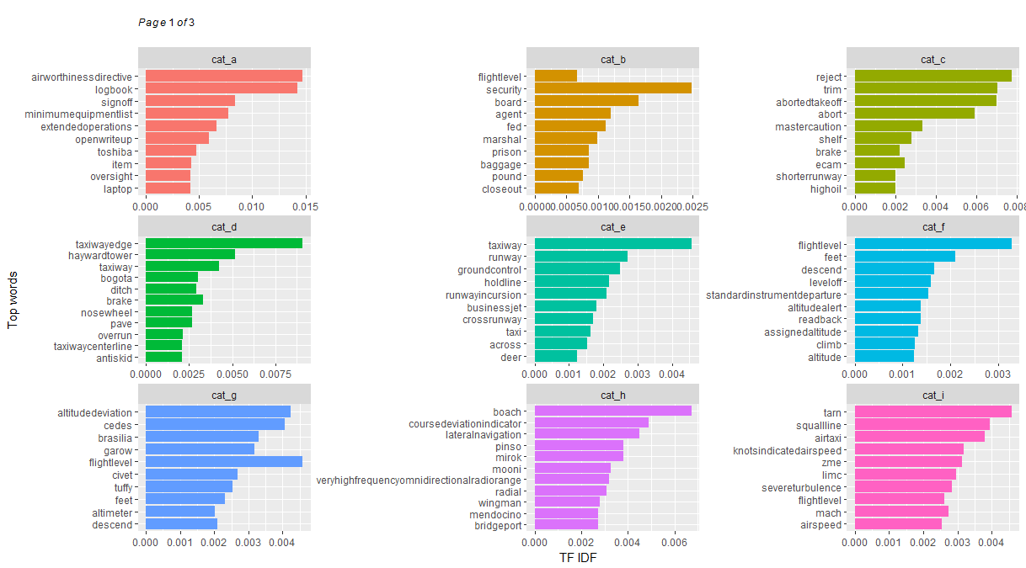
TF-IDF Based Analysis
Rejected, aborted take-offs
On board security issues
On ground violations
Altitude related issues
¹ Remainder of the plots in the appendix

Slide 14
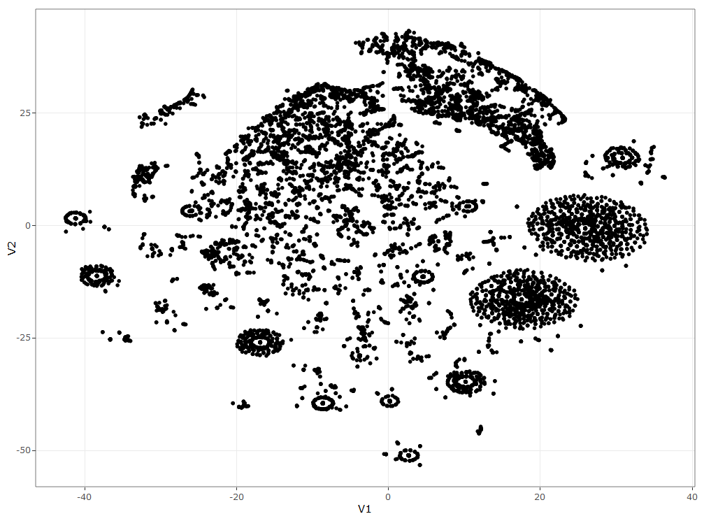
Structural Investigation using tSNE
handcuff, police…
Names of mechanical components
tSNE analysis is performed on the Euclidian distance matrix between the words in the final term-document-matrix
The Rtsne package offers significant compute efficiency vs the tsne package
We can see very clear clusters in the data, which may point to topics in the corpus
Investigation of these points manually using plotly reveals patterns which can be interpreted
Dizzy, kidney, bloody, revive…
doppler radar, turbulence, contingency fuel, thunder storm cell
Ground control related
flippant, passive, difficulty understanding, sarcastic, verbatim...

Slide 15
Structural Topic Modeling
STMs allow researchers to flexibly estimate a topic model
STMs are like LDA models, except they extend the capability to include document-level metadata into the topic model. This allows researchers to not only estimate topics but also relationships to document metadata.
The stm package in R is quite powerful with many features which work well with the tidyverse, tm, quanteda and other major R packages

Slide 16
Structural Topic Modeling
STMs allow researchers to flexibly estimate a topic model
STMs are like LDA models, except they extend the capability to include document-level metadata into the topic model. This allows researchers to not only estimate topics but also relationships to document metadata.
The stm package in R is quite powerful with many features which work well with the tidyverse, tm, quanteda and other major R packages
Using stm, there are two main approaches towards deciding how many topics (K) are contained in the corpus:
Define the value(s) of K yourself
Use tsne to perform a dimension reduction on the TDM followed by some geometric calculations to estimate the number of “groupings”
This method resulted in 116 topics!
To begin with, I’m assuming K=10

Slide 17
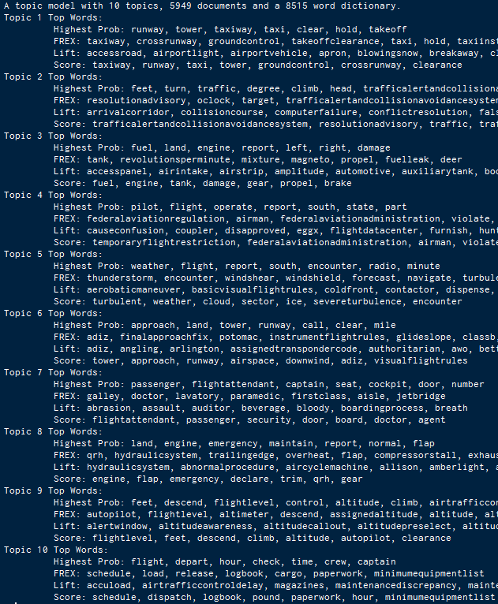
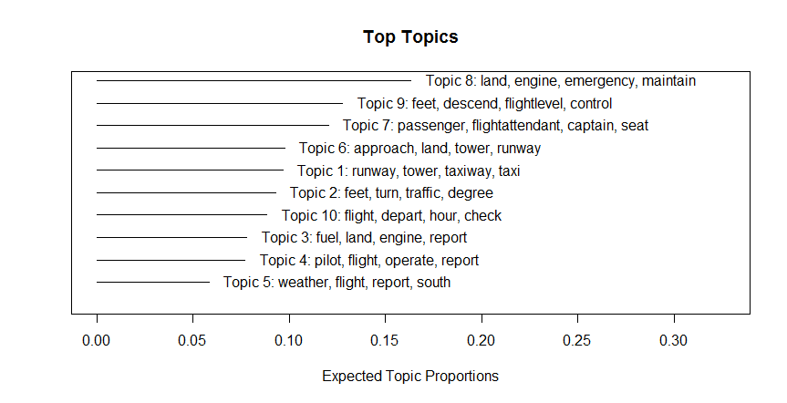
STM Results, K=10
X

Slide 18
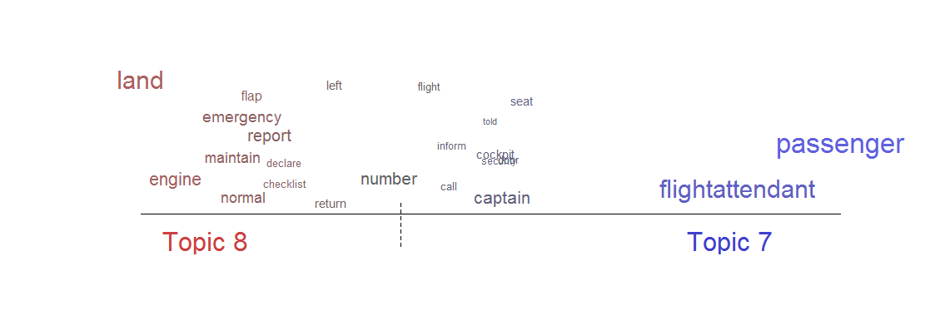
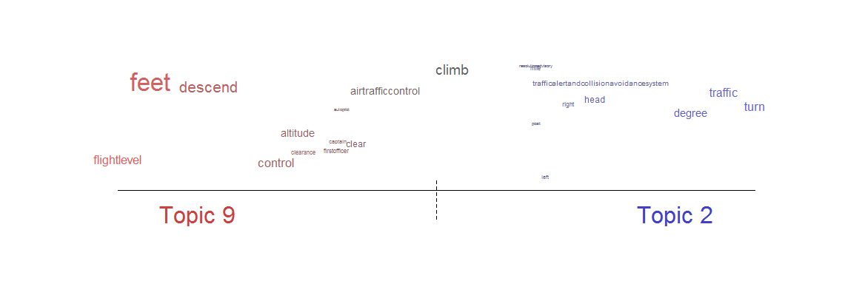
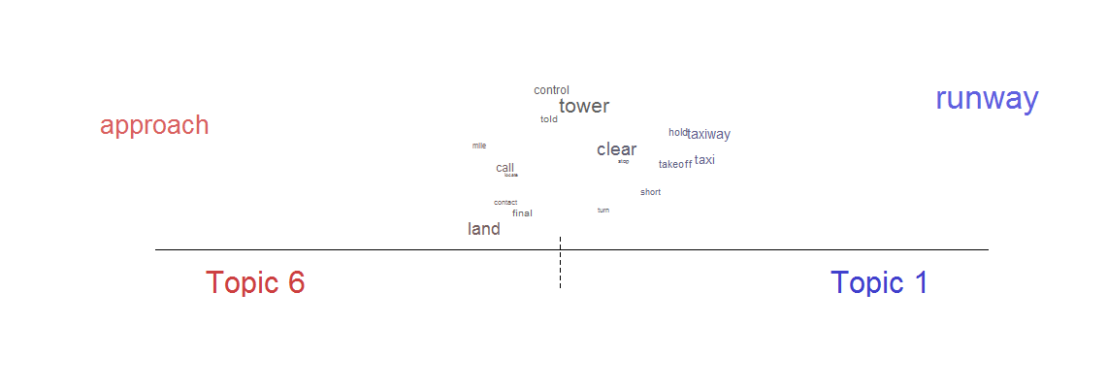

Slide 19
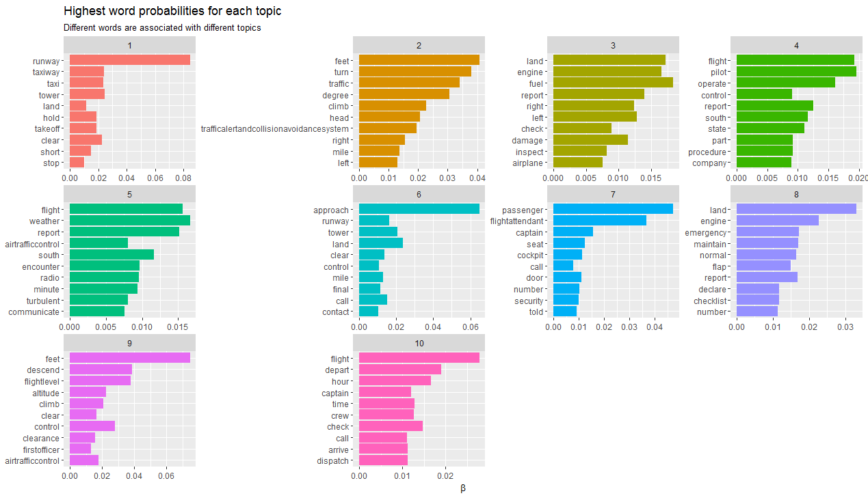

Slide 20
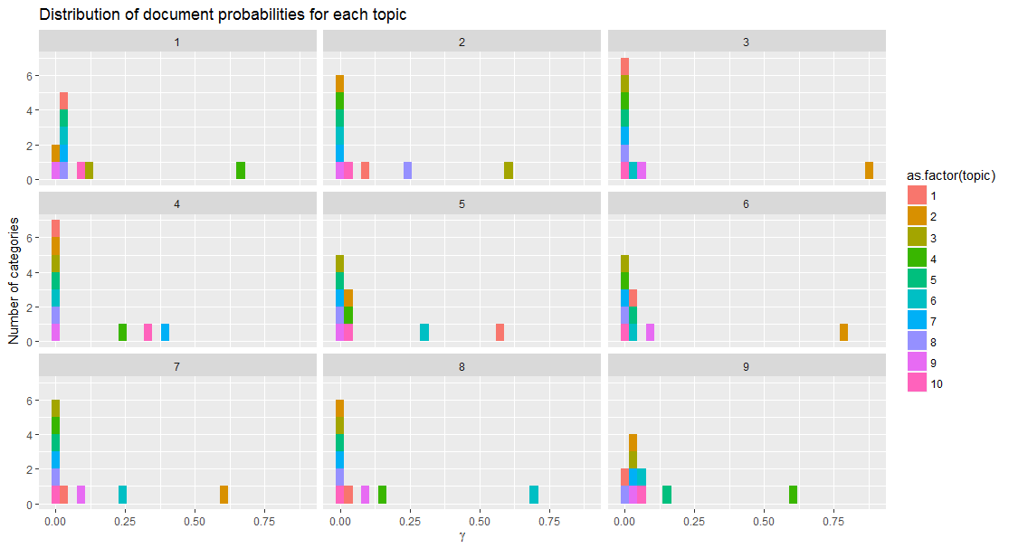

Slide 21
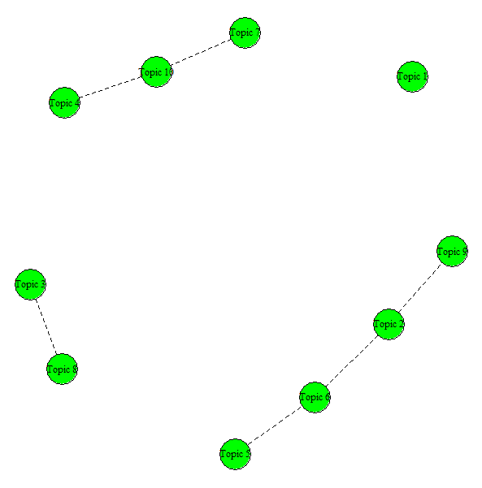

Slide 22
Conclusions

Slide 23
Lessons Learnt

Slide 24
References

Slide 25
Appendix

Slide 26
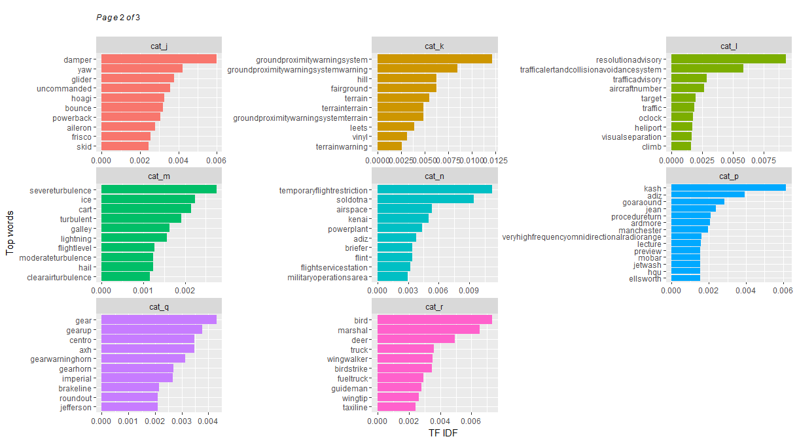
TF-IDF Based Analysis

